Slide 1

Capstone Project – I: Review – 2 on
Cloud-IoT Based Environmental Monitoring and Alert System
Presented by the Batch No. : 88
G Moukthika Sri Srujana BU22CSEN0102316
Kunthalapati Sreeya BU22CSEN0102310
Sreekar Venkata Kanduri BU22CSEN0101143
Uppala Dhanush Shankar BU22CSEN0100265
Under the Guidance of
Dr Thirumalai Selvan C
Assistant Professor
Department of Computer Science and Engineering
GITAM School of CSE, GITAM (Deemed to be University),
Bengaluru, Karnataka, INDIA.

Slide 2
CONTENTS
Recap of Capstone Project Introduction Review-1
  Problem Statement
  Objectives
  Feedback from Guide/Reviewers and actions taken after Review–1
Requirement Analysis
Identification of tools/technology/algorithms
Design Strategy (project workflow/ system design/ DFD/UML design)
Conclusion
References

Slide 3
Problem Statement
Rising air pollution, water contamination, and climate anomalies demand continuous monitoring, but existing systems are limited.
Traditional monitoring approaches are manual, slow, and lack real-time responsiveness.
Current IoT systems often struggle with sensor accuracy, reliability, and calibration issues.
Many solutions collect data but fail to provide timely alerts or automated actions.
There is no scalable, cloud-integrated system that ensures reliable monitoring and intelligent alerting across diverse environments.

Slide 4
Objectives
Main Objective
To design and develop a Cloud-IoT based intelligent system for real-time environmental monitoring and alerting that addresses the drawback of sensor accuracy and reliability in existing methods through calibration, error-handling, drift correction techniques, and the use of the Kalman Filter algorithm for noise reduction and reliable data fusion.
Specific Objectives
Overcome sensor accuracy and reliability issues using calibration, error-handling, drift correction, and Kalman Filter.
Enable real-time data collection and monitoring using IoT-based sensors.
Integrate with cloud platforms for scalable data storage, processing, and analytics.
Implement automated and accurate alert mechanisms (SMS, email, mobile notifications) for timely response.

Slide 5
Feedback from Guide/Reviewers and actions taken after Review–1
<Use Times New Roman Font with 20 size for running text in the ppt slide>
Feedback from Guide/Reviewers
1.
2.
3.
Actions taken
1.
2.
3.

Slide 6
Requirement Analysis
Functional Requirements
Real-time data acquisition from IoT sensors (air, water, climate).
Reliable sensor data ingestion via MQTT/HTTP with edge buffering.
Preprocessing: calibration, noise filtering, drift correction, Kalman filter.
Scalable cloud storage for time-series and analytics data.
Streaming data delivery to visualization dashboard.
Automated anomaly detection and intelligent alerting (SMS, email).
Web-based dashboard for visualization and data trends.

Slide 7
Non-Functional Requirements
Performance: Data delay < 2s, API latency < 200ms.
Reliability: 24/7 uptime with automatic sensor reconnection.
Scalability: Supports 100+ IoT nodes via cloud horizontal scaling.
Accuracy: >95% accuracy with calibration, Kalman filter, and drift correction.
Security: TLS encryption and role-based dashboard access.
Maintainability: Modular design, clear documentation, GitHub version control.

Slide 8
Hardware Requirements
Sensors: MQ135, pH, DHT22 (temperature/humidity).
Raspberry Pi 4 or equivalent gateway for local data aggregation.
Wi-Fi / LoRa / LTE modules for communication.
Cloud-connected servers or VMs for backend and ML processing.
Calibration instruments and weatherproof sensor enclosures.

Slide 9
Software Requirements
Edge firmware: Arduino IDE / MicroPython for IoT nodes.
Messaging middleware: MQTT broker (Mosquitto / AWS IoT Core).
Backend: FastAPI / Node.js REST & WebSocket service.
Database: Firebase.
Frontend: React.js, Chart.js / Grafana dashboards.
ML environment: Python (TensorFlow, scikit-learn, pandas, NumPy).
Containerization: Docker, orchestration via Kubernetes.
CI/CD integration for continuous deployment and versioning.

Slide 10
Identification of tools/technology/algorithms
Tools
VS Code for development.
Git, GitHub for version control and collaboration.
Postman for API testing and validation.
Python data simulation for sensor data (pandas, asyncio, mqtt).
Docker Desktop for container orchestration.
Grafana for monitoring system performance.
Terraform templates for infrastructure automation.
ClickUp for project tracking and documentation.

Slide 11
Identification of tools/technology/algorithms
Technologies
IoT Layer: NodeMCU / ESP32 microcontrollers with MQTT protocol.
Cloud Layer: AWS IoT Core / Azure IoT Hub, S3 / Blob Storage.
Messaging & Streaming: MQTT, Kafka, WebSocket.
Backend Layer: FastAPI (Python) / Node.js (Express/NestJS).
Frontend Layer: React.js, Chart.js, Grafana visualization dashboards.
ML Layer: TensorFlow, scikit-learn, PyTorch.
Security Layer: OAuth2, JWT, HTTPS/TLS encryption.
Container Layer: Docker, Kubernetes for deployment and scaling.
Edge Layer: Raspberry Pi for local buffering and preprocessing.

Slide 12
Identification of tools/technology/algorithms
Algorithms
Kalman Filter for sensor fusion and noise reduction.
Data preprocessing: outlier removal, normalization, interpolation.
Anomaly detection using Random Forest, LSTM, and Isolation Forest.
Threshold-based rules for immediate alert triggering.
Forecasting: ARIMA / Prophet for predictive trend analysis.
Model evaluation: precision, recall, F1-score, ROC/AUC metrics.
Data aggregation and drift correction for continuous calibration

Slide 13
Design Strategy
Project Workflow
1. Data Sensing
(Sensors / IoT Node)
2. Edge Processing
(Kalman Filter)
3. Cloud Ingestion
(MQTT)
4. Cloud Storage
(Analytics)
5. Real-time Alerting
(SMS / Email)
6. User Interface
(Mobile / Web App)

Slide 14
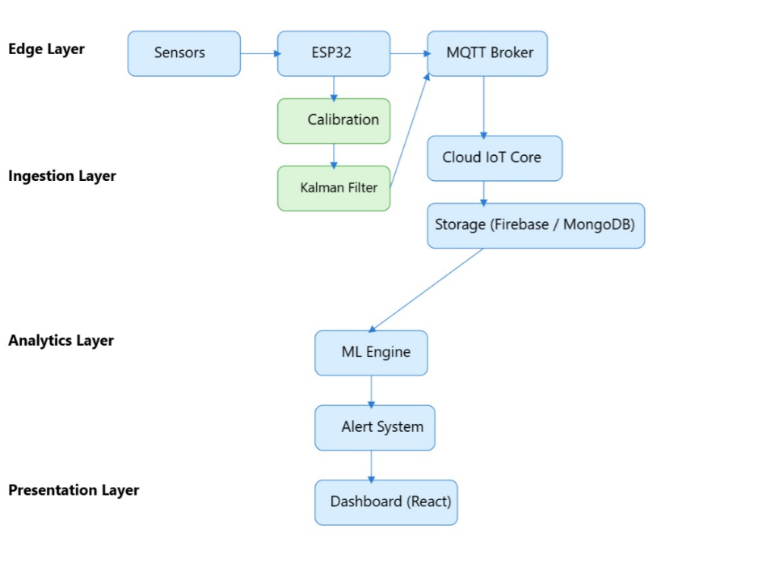
Design Strategy
System Design

Slide 15
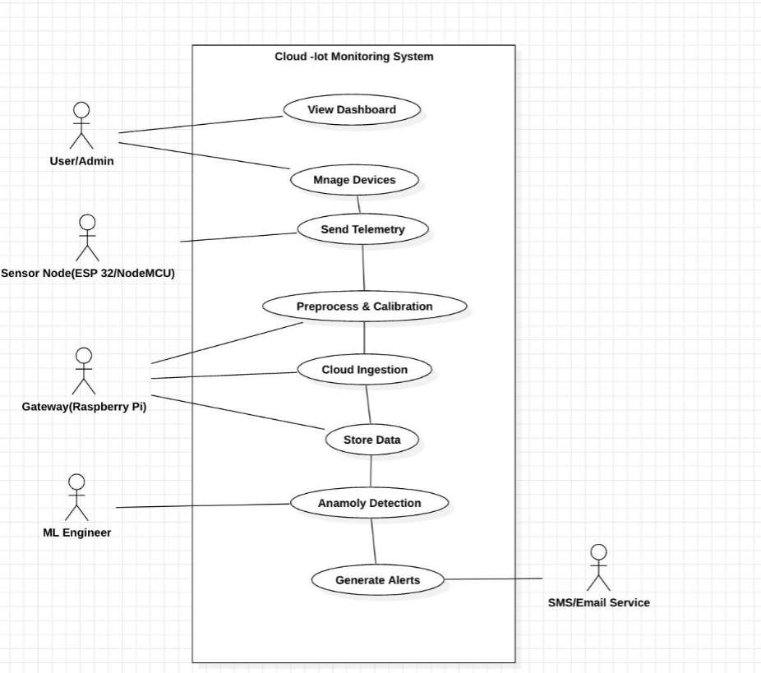
Design Strategy
UML Diagrams : Use Case Diagram

Slide 16
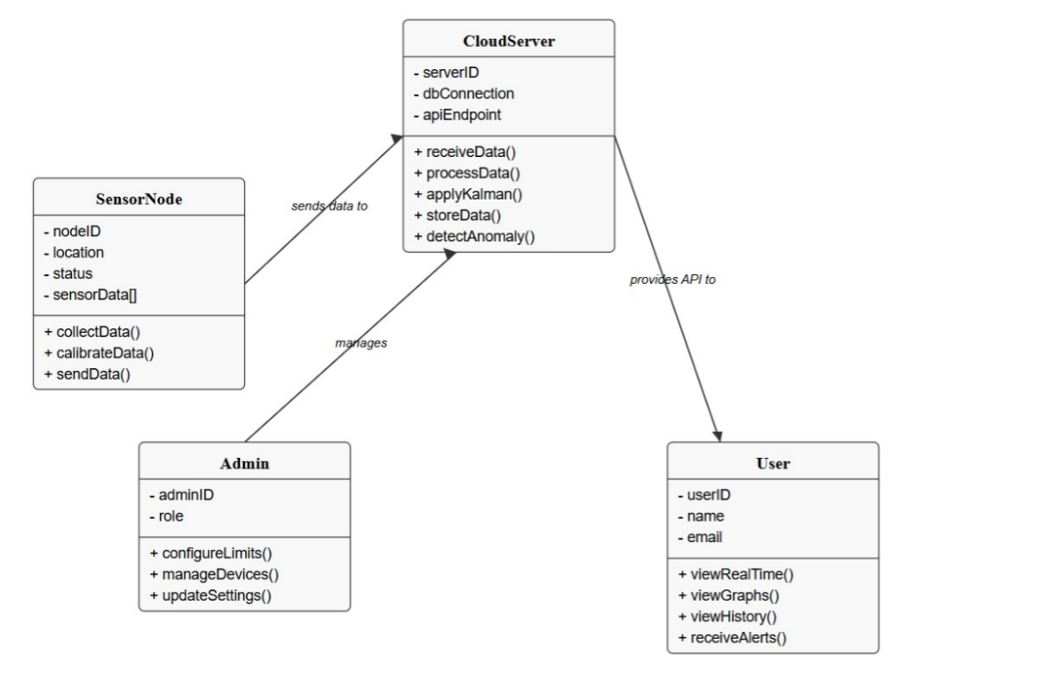
UML Diagrams : Class Diagram

Slide 17
Conclusion
Our project successfully integrates IoT, cloud, and machine learning for real-time environmental monitoring.
The system can collect, process, and analyze data efficiently using sensors and cloud storage.
Machine learning helps detect anomalies and send alerts through SMS or email.
The design ensures accuracy, reliability, and scalability for future improvements.
Overall, the project helps in smart and automated environmental monitoring.

Slide 18
References
[1] Shah, A. A., Reddy, G. A., & Kaviya, V. (2023). Multiutility & Customizable Environment Monitoring System with the Healthcare Utilities. International Journal for Multidisciplinary Research (IJFMR), Vol. 5, Issue 5, Sept–Oct 2023. E-ISSN: 2582-2160.
•
[2] Narayana, T. L., Venkatesh, C., Kiran, A., Babu, C. J., Kumar, A., Khan, S. B., Almusharraf, A., & Quasim, M. T. (2024). Advances in real time smart monitoring of environmental parameters using IoT and sensors. Heliyon, 10, e28195. Elsevier.
•
[3] Singh, B., Thakur, A., Chauhan, D., Srivastava, S., & Pant, V. K. (2025). IoT-Based Smart Sensors for Environmental Pollution Detection and Control. Stallion Journal for Multidisciplinary Associated Research Studies, 2nd ICMRI Conference Proceedings.
[4] J. Jo, B. Jo, J. Kim, S. Kim, and W. Han, “Development of an IoT-Based Indoor Air Quality Monitoring Platform,” Journal of Sensors, vol. 2020, pp. 1–14, Jan. 2020

Slide 19
[5] C. Gopi, V. Pramodh, M. S. Charan, K. S. K. Reddy, and D. SaiVamsi, “Cloud-Based Air Quality Monitoring through Wireless Sensor Network Using NodeMCU,” International Journal for Research in Applied Science & Engineering Technology (IJRASET), vol. 10, no. 12, pp. 911–915, Dec. 2022.
[6] L. Moses, Tamilselvan, Raju, and Karthikeyan, “IoT enabled Environmental Air Pollution Monitoring and Rerouting system using Machine learning algorithms,” IOP Conf. Ser.: Mater. Sci. Eng., vol. 955, p. 012005, 2020.
[7] S. P. Nikam and S. M. Kulkarni, “IoT based Environmental Monitoring System,” Int. J. Eng. Res. Technol. (IJERT), vol. 10, no. 6, pp. 845–850, Jun. 2021.
[8] S. R. Laha, B. K. Pattanayak, and S. Pattnaik, “Advancement of Environmental Monitoring System Using IoT and Sensor: A Comprehensive Analysis,” AIMS Environmental Science, vol. 9, no. 6, pp. 771–800, Nov. 2022.

